Slide 1
E-COMMERCE SENTIMENT ANALYSIS
-Group 8, ADSML Cohort 6
-Akshay, Udith, Shanmugavalli, Srinivas, Manisha, Swapnil, Basker
-Mentor: Sriram

Slide 2
Problem Statement
Develop a sentiment prediction model that classifies customer’s purchase review by leveraging the features and unstructured text data, enabling sentiment analysis for customer feedback.
Abstract
This research presents a hybrid approach to sentiment analysis of product reviews by using textual features to predict customer satisfaction levels. The study leverages advanced Neural Networks, Natural Language Processing (NLP) techniques and machine learning algorithms to process and analyse complex review data, incorporating unstructured text content. Through comprehensive experimentation with traditional machine learning models, neural networks, and Large Language Models (LLMs), we develop an optimized framework for sentiment classification. The resulting model demonstrates robust performance in automatically categorizing customer sentiments, providing businesses with capability to generate actionable insights for product improvement and customer experience enhancement.

Slide 3
Measures of Success
Building a sentiment analysis system that can accurately classify customer reviews into sentiment categories (“Positive”, “Negative”, or “Neutral”).
Below are the project aims to achieve
Explore variety of text representation techniques such as TF-IDF, Word2Vec, and transformer-based embeddings.
Evaluate varieties of models, including logistic regression, random forests, LSTMs, BERT, and Claude Sonnet LLM, to identify the most effective approach.
Use optimization techniques like hyperparameter tuning, data augmentation, data encoding and auto encoding.
Compare pre-trained neural networks with custom-trained models in terms of accuracy, inference time, and computational cost.
Ensure scalability and adaptability of the solution for deployment on any e-commerce platform.
Validate the model’s performance to ensuring generalizability to unseen data and across variety of use cases.

Slide 4
Methodology
Section 1: Dataset Cleaning and Exploratory Data Analysis
Section 2: Training Neural Networks from Scratch
Section 3: Fine tuning Pre-trained Model
Section 4: Using pre-trained LLMs for Sentiment Classification
Section 5: Using conventional ML models and embeddings
Section 6: Conclusion and Comparison of outcomes from different models
Section 7: Code Base and Documentation
References.

Slide 5
Section 1: Exploratory Data Analysis

Slide 6
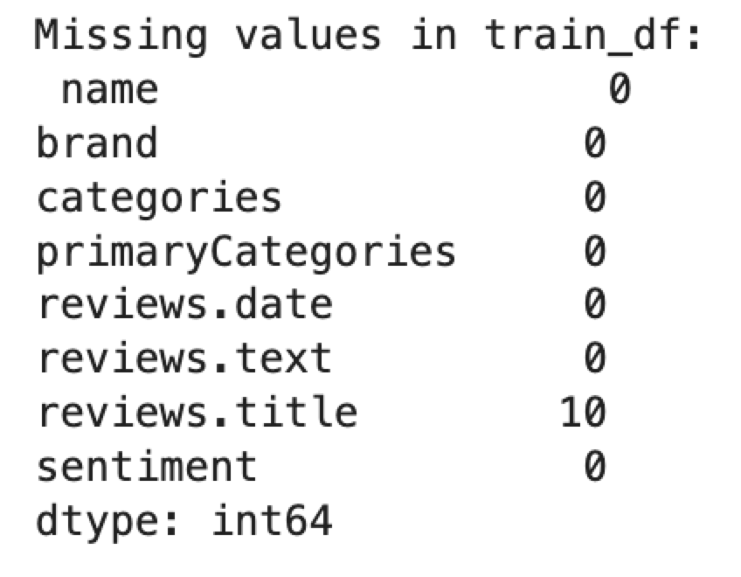
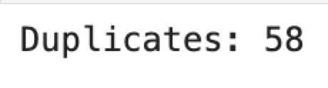
Data Cleaning and Exploratory Data Analysis
Review Title | Review Text | Sentiment
very handy device | Amazon kindle fire has a lot of free app and can be used by any one that wants to get online anywhere | Positive
Another winner from Amazon | The Echo Show is a great addition to the Amazon family. Works just like the Echo, but with a 7" screen. Bright vibrant display. Rich clear sound. Works great with Arlo security cameras. Excellent smart home addition. Just hope Google and Amazon start playing nice with each other soon so Youtube will work again. | Positive
Good | It's ok but I rather have bought Samsung Galaxy Tab | Neutral
Not what I need. | I can't update Facebook and a few other apps. It's not what I expected. | Negative

Slide 7
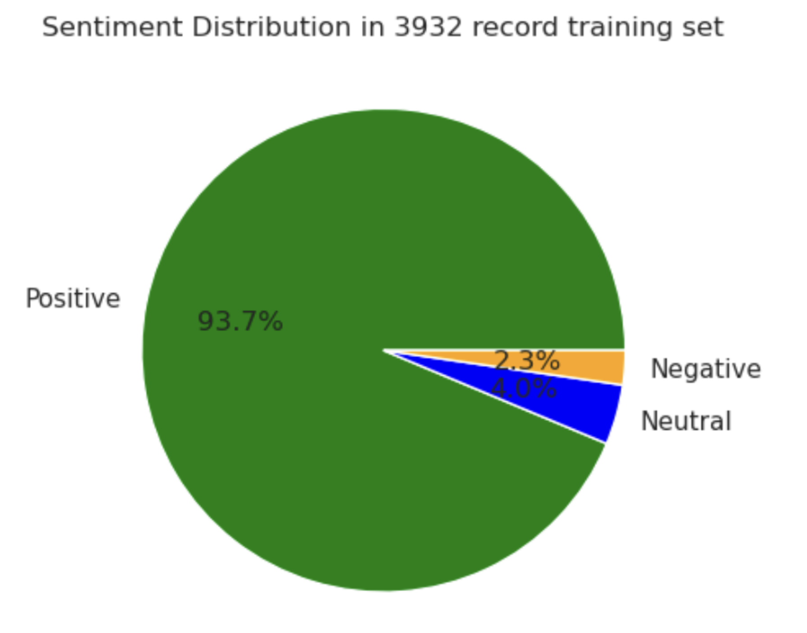
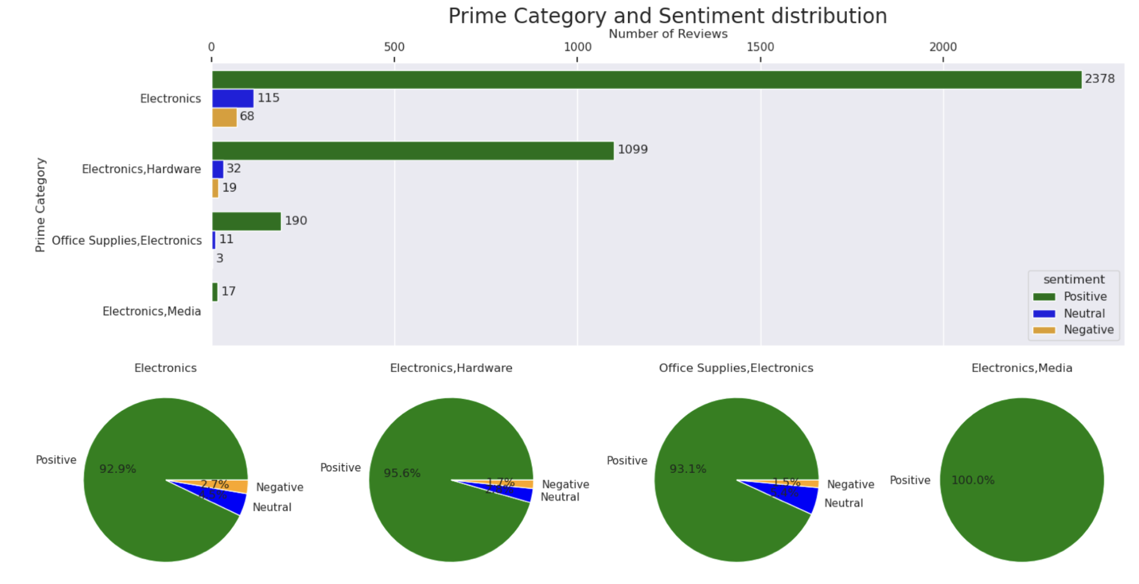
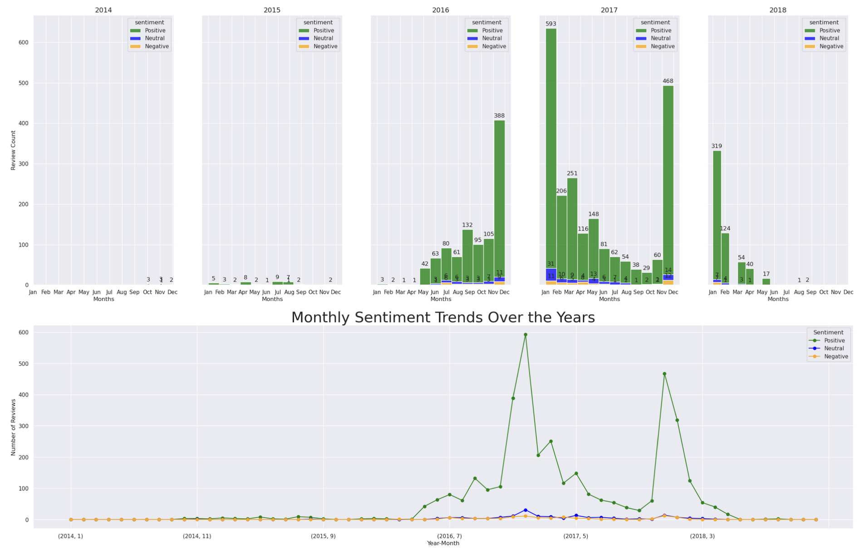
Data Cleaning and Exploratory Data Analysis

Slide 8
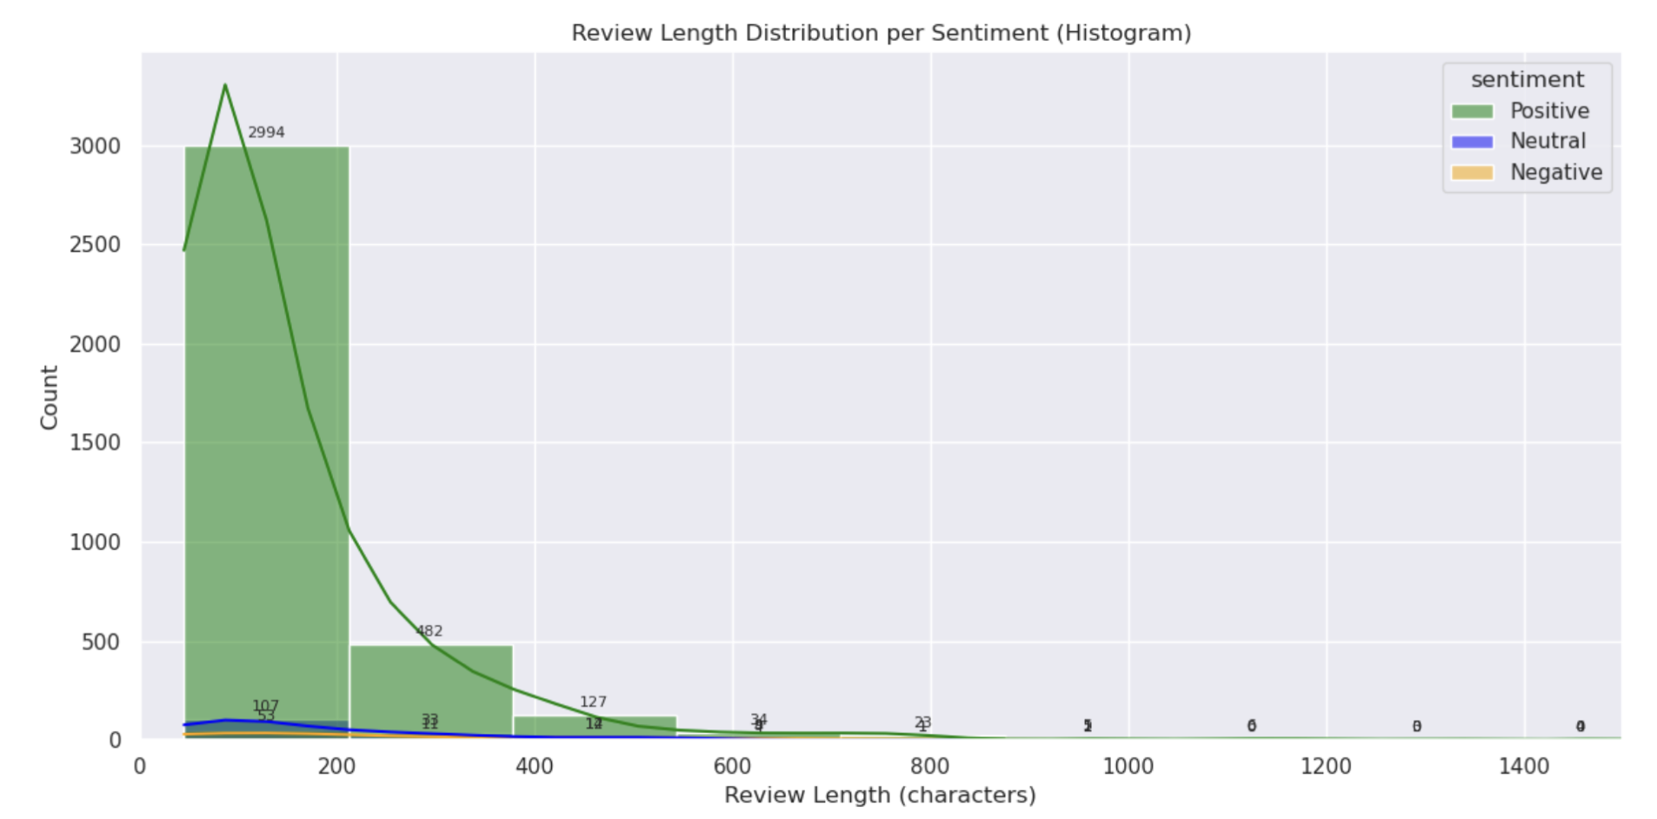
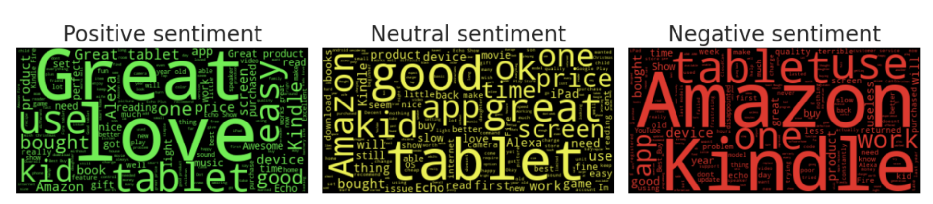
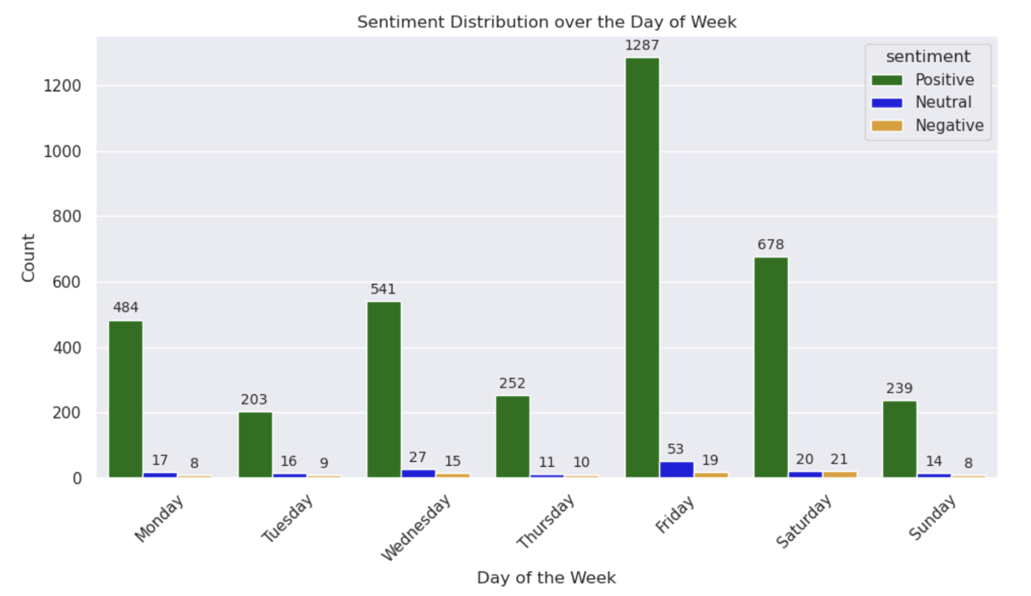
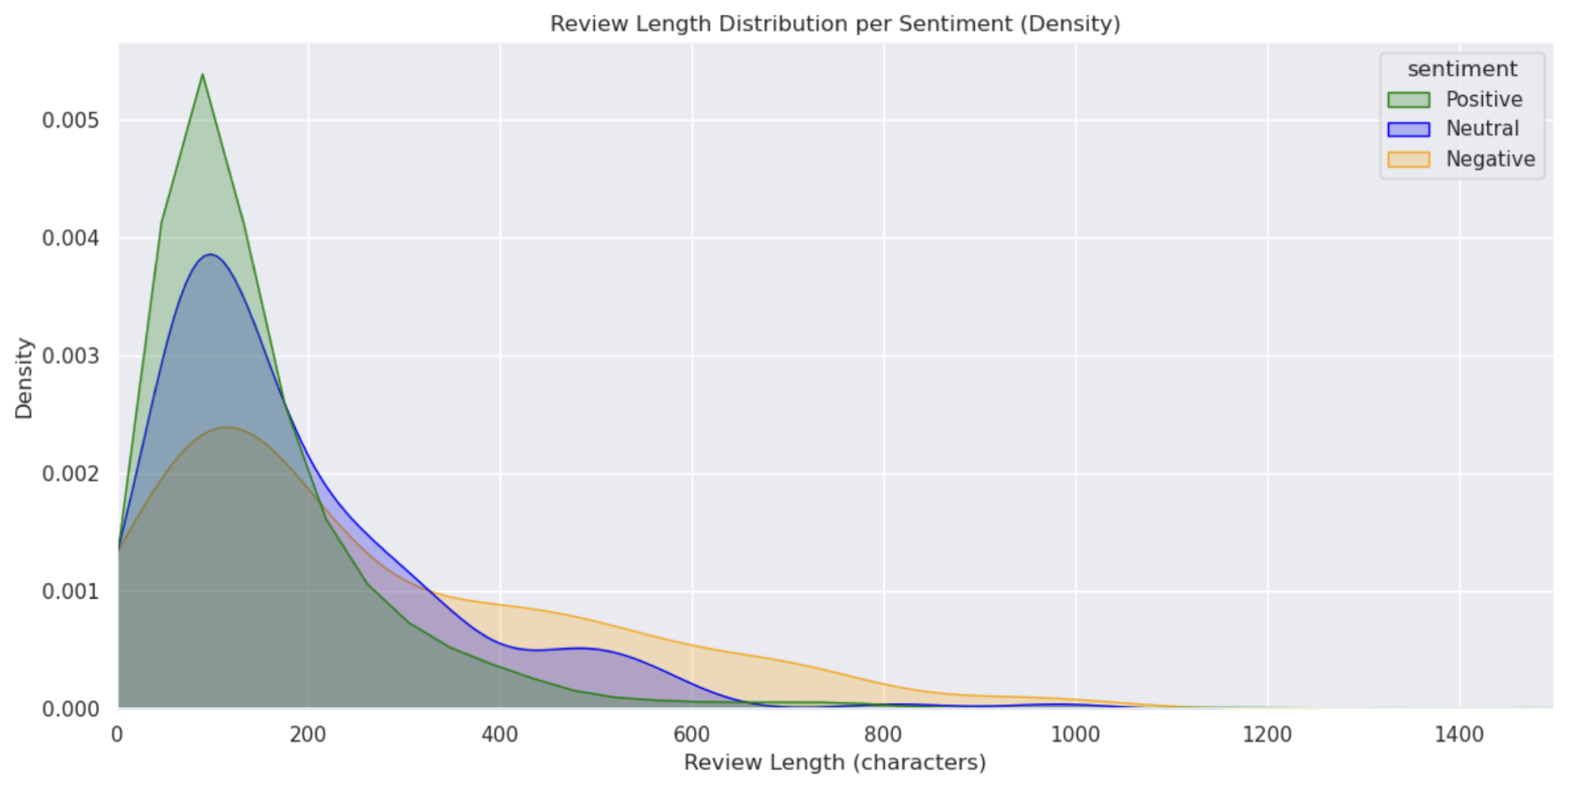
Data Cleaning and Exploratory Data Analysis

Slide 9
Section 2: Training Neural Networks From Scratch

Slide 10
AI Prototypes : Neural Network Model Variations
# | Model | SBERT | SMOTE/ Tomek | MLP | LSTM | GRU | Transformer | Class Weighing | Pipeline / 2Stage | Auto -Encoder | Embedding Scaling | Pre-Trained BERT | Fine-Tuning BERT | Prompt Engineering
1 | NN #1 | ✓ | ✓ | ✓
2 | NN #2 | ✓ | ✓ | ✓
3 | NN #3 | ✓ | ✓ |  | ✓
4 | NN #4 | ✓ | ✓ |  |  | ✓
5 | NN #5 | ✓ | ✓ |  |  |  | ✓
6 | NN #6 | ✓ | ✓ |  |  |  | ✓ | ✓
7 | NN #7 | ✓ | ✓ |  |  |  | ✓ | ✓ | ✓
8 | NN #8 | ✓ | ✓ |  |  |  | ✓ | ✓ | ✓ | ✓
9 | NN #9 | ✓ | ✓ |  |  |  |  |  | ✓ | ✓ | ✓
10 | NN #10 | ✓ | ✓ |  |  |  |  |  | ✓ | ✓ | ✓
11 | Ensemble | ✓ | ✓ | ✓ | ✓ | ✓ | ✓ | ✓ | ✓ | ✓ | ✓
Pre-trained Masked Language Modelling Approach
12 | RoBERTa #1 |  |  |  |  |  | ✓ |  |  |  |  | ✓
13 | RoBERTa #2 |  |  |  |  |  | ✓ |  |  |  |  | ✓ | ✓
LLM Based Modelling Approach
14 | GenAI #1 |  |  |  |  |  |  |  |  |  |  |  |  | ✓

Slide 11
NN #1: Sentence BERT with SMOTE + Simple Neural Network
Component | Description | Purpose / Role | Key Parameters / Details
SBERT | Sentence-BERT model all-MiniLM-L6-v2 | Converts text reviews into 384-dimensional dense sentence embeddings | Pre-trained transformer model; embedding size = 384
SMOTE | Synthetic Minority Over-sampling Technique | Balances imbalanced dataset by generating synthetic samples of minority classes | Applied on SBERT embeddings and labels
Neural Network | Fully connected feed-forward neural network built with Tensor Flow Keras Sequential API | Classifies sentiment into 3 classes (Negative, Neutral, Positive) | 5 Dense layers with ReLU + Softmax output; L2 regularization (l2=0.001) Batch Norm Dropout (0.3-0.5)
Layer Type | Units | Activation | Regularization | Batch Norm | Dropout Rate
Dense (Input) | 384 | ReLU | L2 (0.001) | Yes | 0.5
Dense | 256 | ReLU | L2 (0.001) | Yes | 0.5
Dense | 128 | ReLU | L2 (0.001) | Yes | 0.4
Dense | 64 | ReLU | L2 (0.001) | Yes | 0.3
Dense (Output) | 3 | Softmax | None | No | None

Slide 12
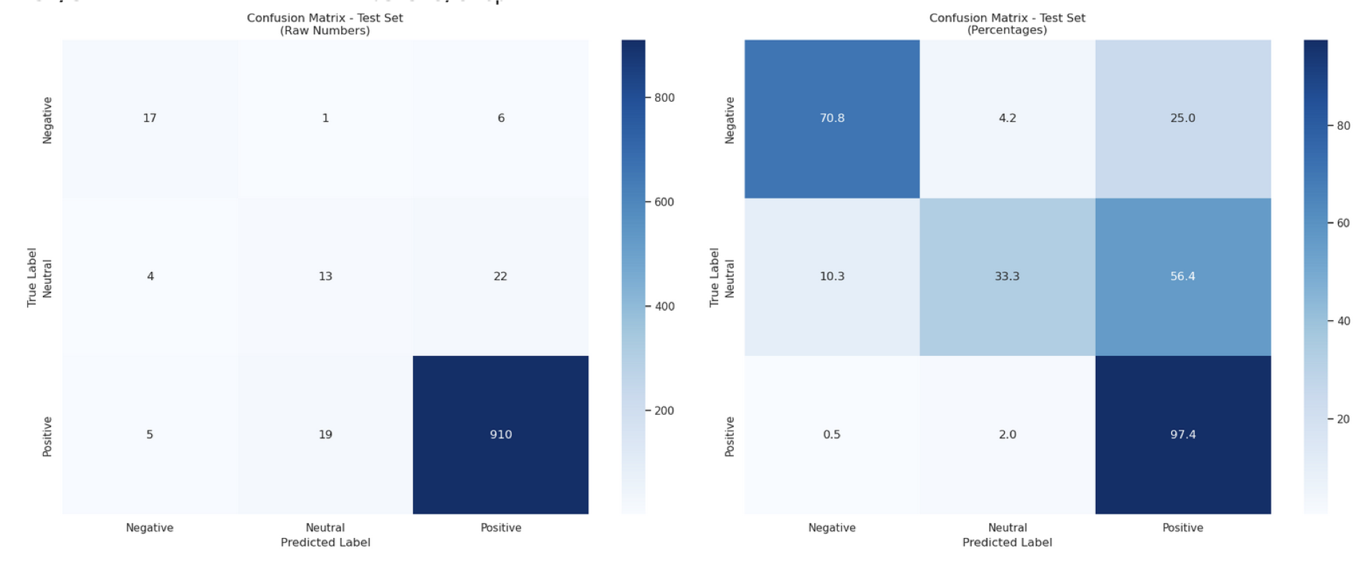
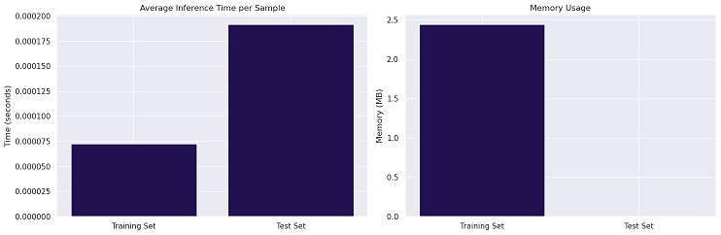

NN #1: Result
Sentiment | Precision | Recall | F1-score | Support
Negative | 0.65 | 0.62 | 0.64 | 24
Neutral | 0.54 | 0.38 | 0.45 | 39
Positive | 0.97 | 0.98 | 0.98 | 934
Accuracy |  |  | 0.95 | 997
Inference Time per Sample | 0.0002 seconds
Memory Usage | 0.04 MB

Slide 13
NN #2: Sentence BERT with SMOTE Tomek + Simple Neural Network
Component | Description
Input | 384-dimensional SBERT embedding vector per sample
Data Balancing | SMOTE-Tomek applied to embeddings
Optimizer | Adam (Adaptive Moment Estimation Learning Rate = 0.001)
Loss Function | Sparse categorical cross entropy Loss (Efficient and works with Label Encoded Target)
Training Callbacks | Early Stopping, ReduceLROnPlateau (Reduced Learning Rate when Validation Loss Stops Improving with Epochs), ModelCheckpoint (Save model weights at interval level)
Regularization | L2 on each Dense layer (except output)
Batch Normalization | After each Dense layer (except output)
Dropout | After each Dense layer (except output), rates: 0.5, 0.5, 0.4, 0.3
Layer No. | Layer Type | Output Units | Activation | Regularization | Batch Normalization | Dropout Rate
Input | Dense | 384 | ReLU | L2 (0.001) | Yes | 0.5
2 | Dense | 256 | ReLU | L2 (0.001) | Yes | 0.5
3 | Dense | 128 | ReLU | L2 (0.001) | Yes | 0.4
4 | Dense | 64 | ReLU | L2 (0.001) | Yes | 0.3
Output | Dense | 3 | Softmax | None | No | 0

Slide 14
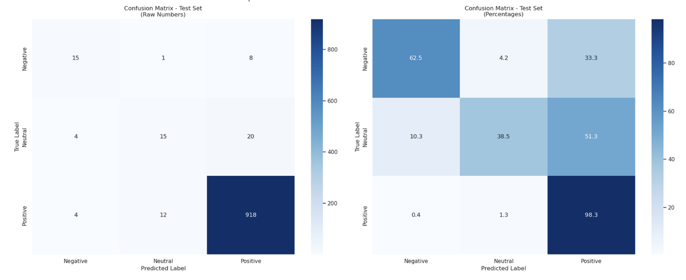
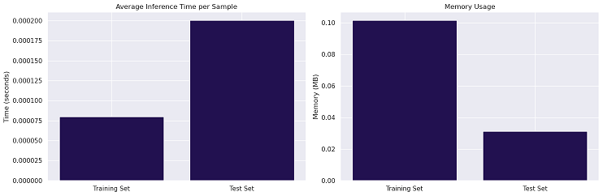
NN #2: Result
Class | Precision | Recall | F1-Score | Support
Negative | 0.65 | 0.71 | 0.68 | 24
Neutral | 0.48 | 0.33 | 0.39 | 39
Positive | 0.97 | 0.98 | 0.97 | 934
Accuracy |  |  | 0.95 | 997
Inference Time per Sample | 0.0002 seconds
Memory Usage | 0.03 MB

Slide 15
NN #3: Sentence BERT with SMOTE Tomek with LSTM
Component | Description
Input | 384-dimensional SBERT embedding vector per sample
Data Balancing | SMOTE-Tomek applied to embeddings
Optimizer | Adam (learning rate = 0.001)
Loss Function | Sparse categorical crossentropy
Training Callbacks | EarlyStopping, ReduceLROnPlateau, ModelCheckpoint
Regularization | L2 on LSTM and Dense layers (except output), L2 = 0.001
Batch Normalization | After each LSTM and Dense layer (except output)
Dropout | After each LSTM and Dense layer (except output), rates: 0.5, 0.5, 0.3
Layer No. | Layer Type | Output Units | Activation | Regularization | Batch Normalization | Dropout Rate
Input | Bidirectional LSTM | 256 | - | L2 (0.001) | Yes | 0.5
2 | Bidirectional LSTM | 128 | - | L2 (0.001) | Yes | 0.5
3 | Dense | 64 | ReLU | L2 (0.001) | Yes | 0.3
Output | Dense | 3 | Softmax | None | No | 0

Slide 16
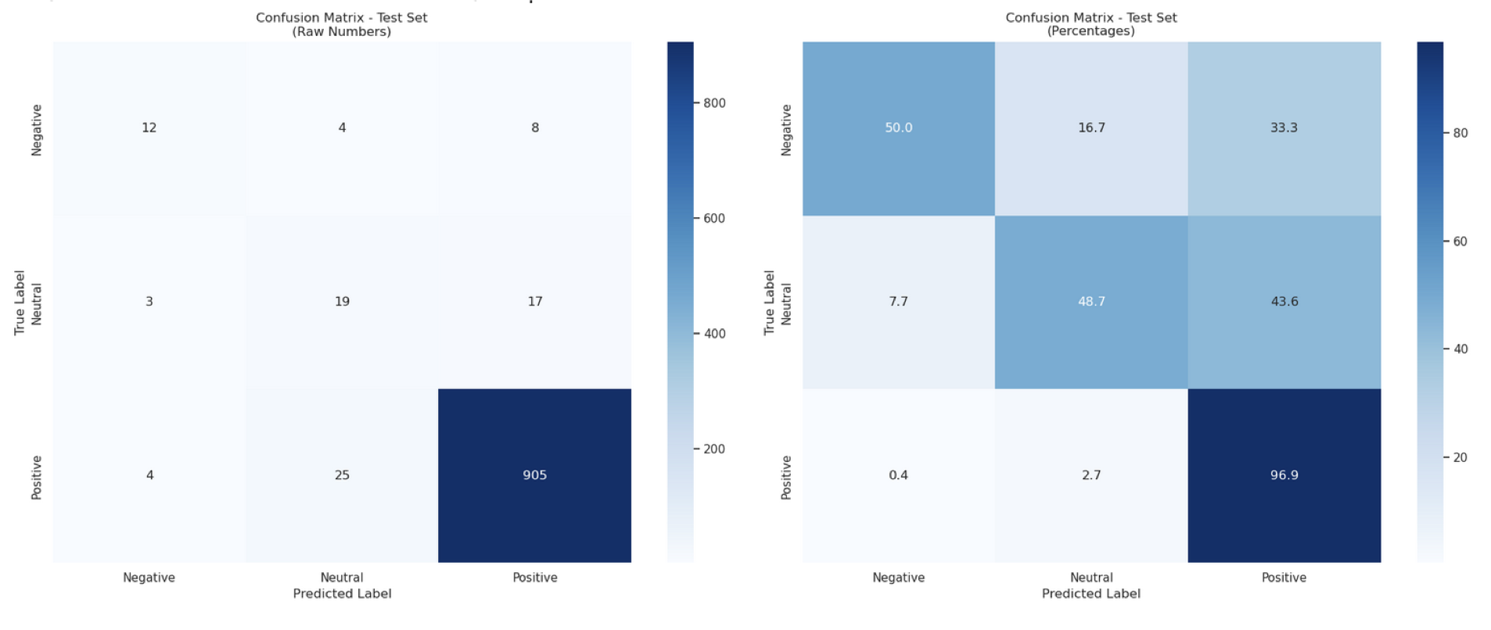
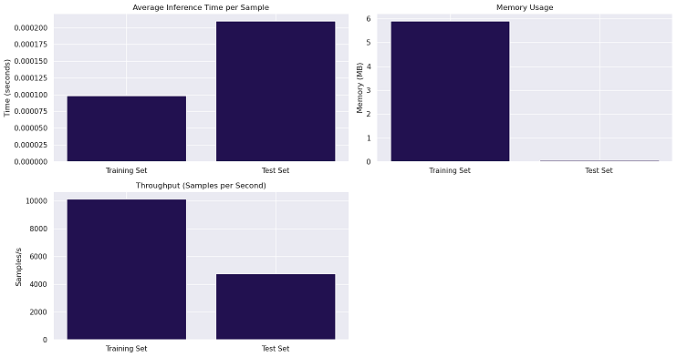
NN #3: Result
Class | Precision | Recall | F1-Score | Support
Negative | 0.59 | 0.54 | 0.57 | 24
Neutral | 0.31 | 0.41 | 0.35 | 39
Positive | 0.97 | 0.96 | 0.97 | 934
Accuracy |  |  | 0.93 | 997
Inference Time per Sample | 0.0002 seconds
Memory Usage | 0.05 MB

Slide 17
NN #4: Sentence BERT with SMOTE Tomek with GRU
Component | Description
Input | 384-dimensional SBERT embedding vector per sample
Data Balancing | SMOTE-Tomek applied to embedding space
Optimizer | Adam (learning rate = 0.001)
Loss Function | Sparse Categorical Cross Entropy
Training Callbacks | EarlyStopping, ReduceLROnPlateau, ModelCheckpoint
Regularization | L2 on GRU and Dense layers (L2 = 0.01)
Batch Normalization | After GRU and Dense layers (except output)
Dropout | After GRU and Dense layers (except output), rates: 0.5, 0.4
Layer No. | Layer Type | Output Units | Activation | Regularization | Batch Normalization | Dropout Rate
Input | Bidirectional GRU | 128 | - | L2 (0.01) | Yes | 0.5
2 | Dense | 64 | ReLU | L2 (0.01) | Yes | 0.4
Output | Dense | 3 | Softmax | None | No | 0

Slide 18
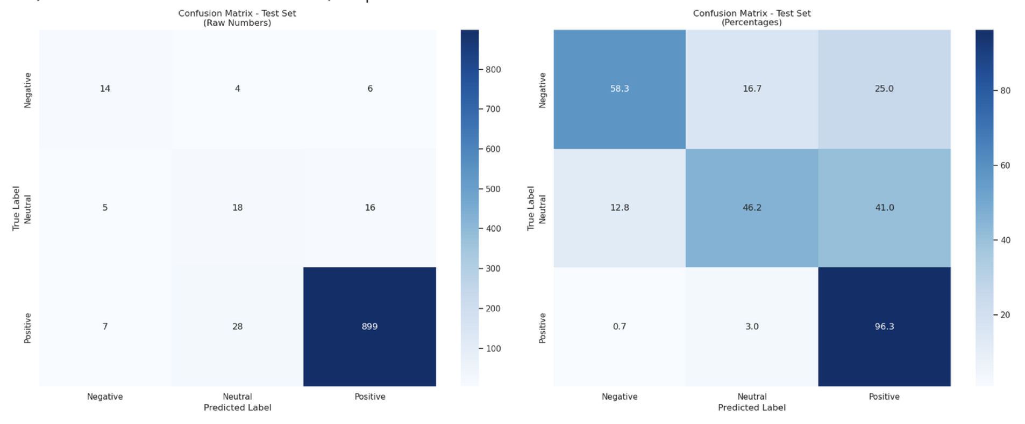
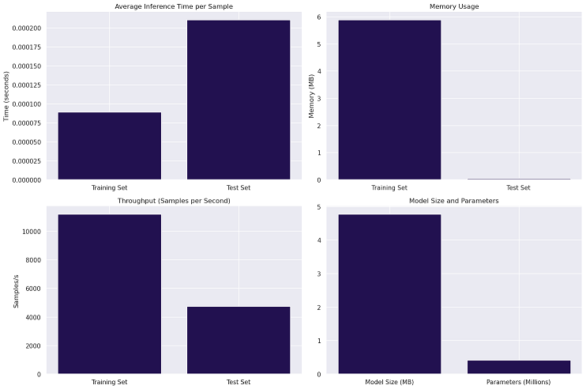
NN #4: Result
Class | Precision | Recall | F1-Score | Support
Negative | 0.55 | 0.67 | 0.60 | 24
Neutral | 0.33 | 0.46 | 0.38 | 39
Positive | 0.98 | 0.96 | 0.97 | 934
Accuracy |  |  | 0.93 | 997
Inference Time per Sample | 0.0002 seconds
Memory Usage | 0.04 MB

Slide 19
NN #5: Sentence BERT with SMOTE Tomek with Transformers
Component | Description
Input | 384-dimensional SBERT embedding vector per sample
Data Balancing | SMOTE-Tomek applied to embeddings
Optimizer | Adam (learning rate = 0.0001)
Loss Function | Sparse Categorical Cross Entropy
Training Callbacks | EarlyStopping, ReduceLROnPlateau, ModelCheckpoint
Regularization | L2 regularization applied within Transformer blocks (not explicitly on Dense layers)
Batch Normalization | LayerNormalization inside Transformer encoder blocks
Dropout | Dropout in MultiHeadAttention (Attention applied at multiple relevant positions) and MLP layers (rates: 0.4 for attention, 0.3 for MLP)
Layer No. | Layer Type | Output Units | Activation | Regularization | Batch / Layer Normalization | Dropout Rate
Input | Input Layer | (1, 384) | - | - | - | -
Encoder | Transformer Encoder Blocks (4 blocks) | 384 (same as input) | ReLU (in FFN) | L2 (implicit in dense weights) | After attention and FFN | 0.4 (attention) 0.3 (FFN)
MLP 1 | Dense | 128 | ReLU | None | No | 0.3
MLP 2 | Dense | 64 | ReLU | None | No | 0.3
Output | Dense | 3 | Softmax | None | No | 0

Slide 20
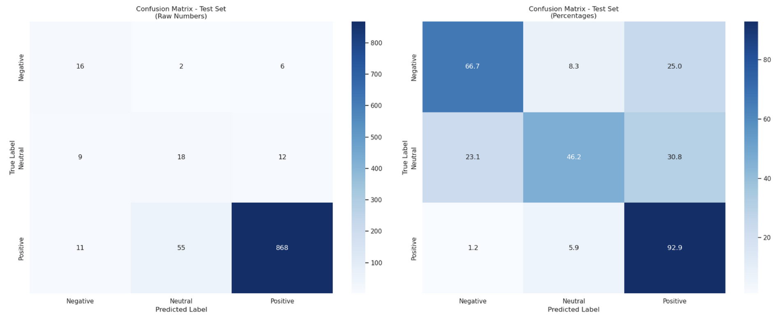
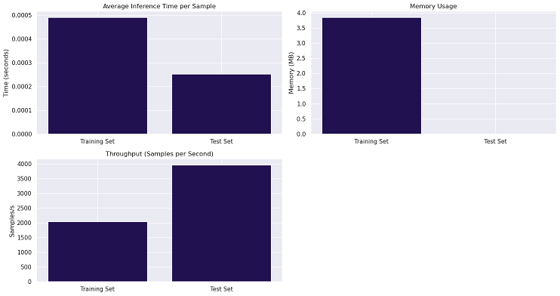
NN #5: Result
Class | Precision | Recall | F1-Score | Support
Negative | 0.5 | 0.54 | 0.52 | 24
Neutral | 0.26 | 0.49 | 0.34 | 39
Positive | 0.98 | 0.94 | 0.96 | 934
Accuracy |  |  | 0.91 | 997
Inference Time per Sample | 0.0003 seconds
Memory Usage | 0.05 MB

Slide 21
NN #6: Sentence BERT + SMOTE Tomek + Transformers + Weighted Loss Function
Component | Description
Input | 384-dimensional SBERT embedding vector per sample
Data Balancing | SMOTE-Tomek applied to embedding space
Optimizer | Adam (learning rate = 0.0001)
Loss Function | Weighted Sparse Categorical Crossentropy
Training Callbacks | EarlyStopping, ReduceLROnPlateau, ModelCheckpoint
Regularization | L2 on Dense layers in Transformer blocks (implicit via Dense, not set globally)
Batch Normalization | LayerNormalization after MultiHeadAttention and Dense layers in each Transformer block
Dropout | After MultiHeadAttention and Dense layers in Transformer blocks and MLP, rates: 0.4, 0.3
Layer No. | Layer Type | Output Units | Activation | Regularization | Batch Normalization | Dropout Rate
Input | Input | (1, 384) | - | None | - | -
01-Jun | Transformer Encoder Block | 384 | ReLU (FFN) | L2 (Dense) | Yes (LayerNorm) | 0.4 (attn), 0.3 (FFN)
7 | GlobalAveragePooling1D | 384 | - | None | - | -
8 | Dense | 256 | ReLU | None | - | 0.3
9 | Dense | 128 | ReLU | None | - | 0.3
Output | Dense | 3 | Softmax | None | No | 0

Slide 22
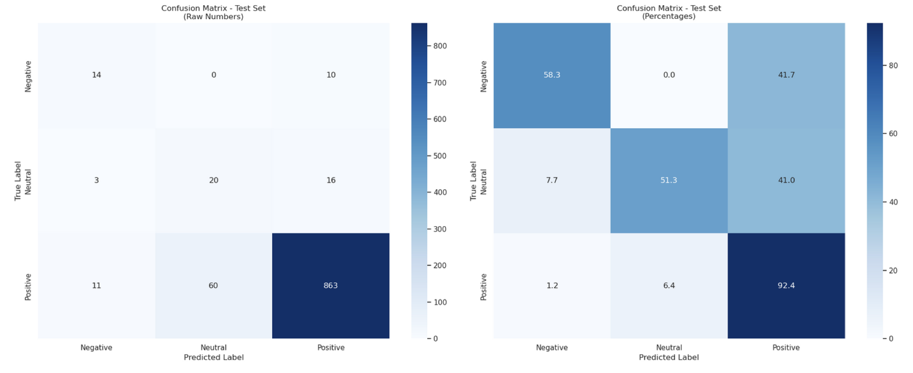
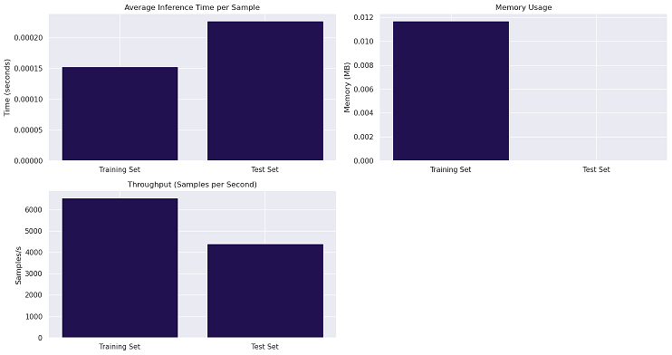
NN #6: Result
Class | Precision | Recall | F1-Score | Support
Negative | 0.62 | 0.62 | 0.62 | 24
Neutral | 0.23 | 0.49 | 0.31 | 39
Positive | 0.97 | 0.93 | 0.95 | 934
Accuracy |  |  | 0.9 | 997
Inference Time per Sample | 0.0002 seconds
Memory Usage | 0.05 MB

Slide 23
NN #7: SBERT + SMOTE Tomek + Transformers + Weighted Loss + Pipeline of Models
Model No. | Model Name | Purpose | Input | Output Classes | Key Layers
1 | Transformer (Positive vs Rest) | Classify Positive vs (Negative / Neutral) | SBERT embedding (1, 384) | 2 (Positive, Rest) | 4 Transformer Encoder Blocks, GlobalAveragePooling1D, Dense(128), Dense(2, softmax)
2 | Transformer (Negative vs Neutral) | Classify Negative vs Neutral (on samples predicted as "Rest" by Model 1) | SBERT embedding (1, 384) | 2 (Negative, Neutral) | 4 Transformer Encoder Blocks, GlobalAveragePooling1D, Dense(128), Dense(2, softmax)
Layer No. | Layer Type | Output Units | Activation | Regularization | Normalization | Dropout Rate
Input | Input | (1, 384) | - | None | - | -
Layer 1 to Layer 4 | Transformer Encoder Block | 384 | ReLU (FFN) | L2 (Dense) | LayerNormalization | 0.4 (attn), 0.3 (FFN)
Layer 5 | GlobalAveragePooling1D | 384 | - | None | - | -
Layer 6 | Dense | 128 | ReLU | None | - | 0.3
Output | Dense | 2 | Softmax | None | No | 0

Slide 24
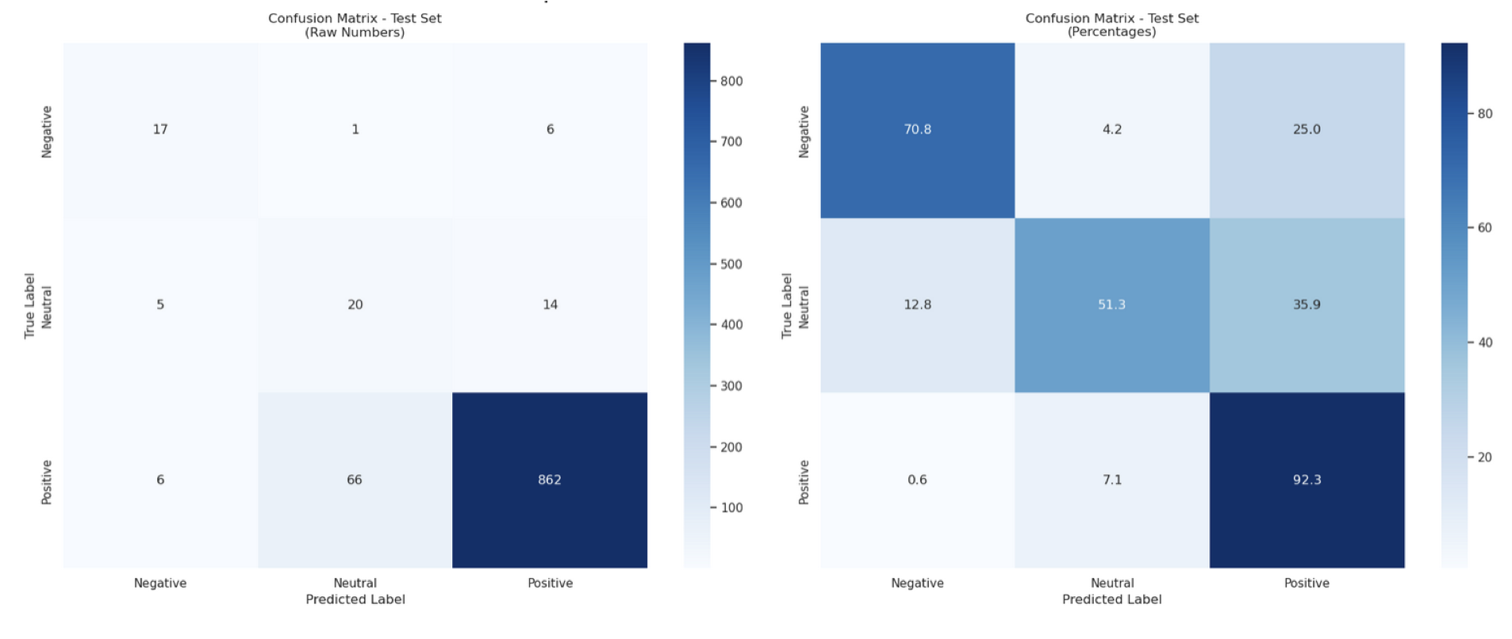
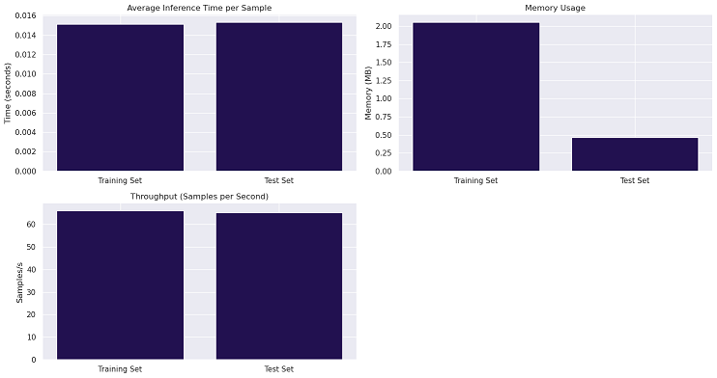
NN #7: Result
Class | Precision | Recall | F1-Score | Support
Negative | 0.67 | 0.67 | 0.67 | 24
Neutral | 0.3 | 0.56 | 0.39 | 39
Positive | 0.98 | 0.94 | 0.96 | 934
Accuracy |  |  | 0.92 | 997
Inference Time per Sample | 0.0153 seconds
Memory Usage | 0.46 MB

Slide 25
NN #8: SBERT + SMOTE Tomek + Transformers + Weighted Loss + Pipeline of Model + Autoencoders
Stage | Model | Purpose | Input | Output Classes
1 | Transformer (Positive vs Rest) | Classify Positive vs (Negative/Neutral) | Encoded SBERT (1,128) | 2
2 | Transformer (Negative vs Neutral) | Classify Negative vs Neutral | Encoded SBERT (1,128) | 2
Layer No. | Layer Type | Output Units | Activation | Regularization | Batch / Layer Normalisation | Dropout Rate
Input | Input | (1, 128) | - | None | - | -
Layer 1 to Layer 4 | Transformer Encoder Block | 128 | ReLU (FFN) | L2 (Dense) | Yes | 0.4 (attn), 0.3 (FFN)
Layer 5 | GlobalAveragePooling1D | 128 | - | None | - | -
Layer 6 | Dense | 64 | ReLU | None | - | 0.3
Output | Dense | 2 | Softmax | None | No | 0

Slide 26
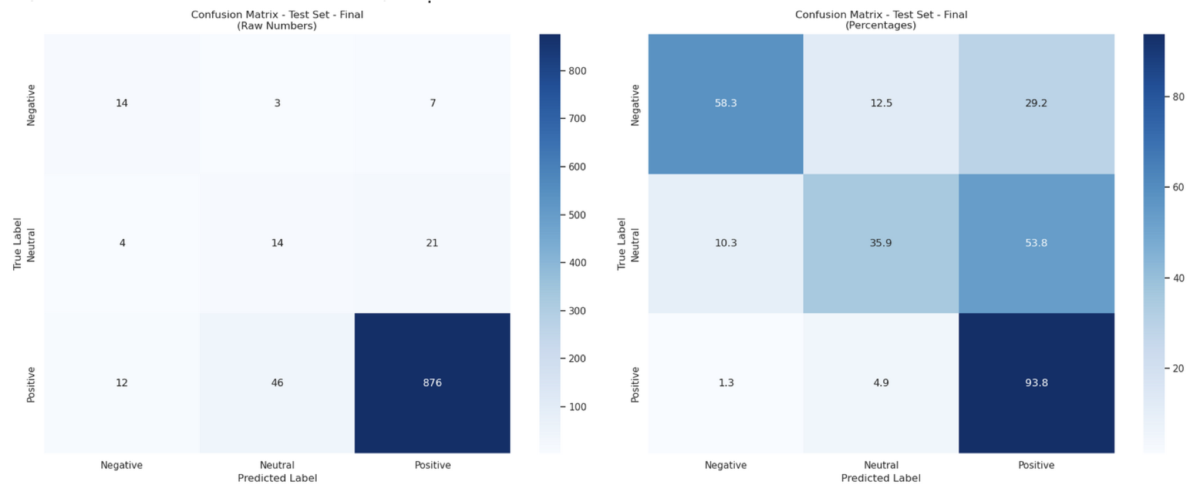
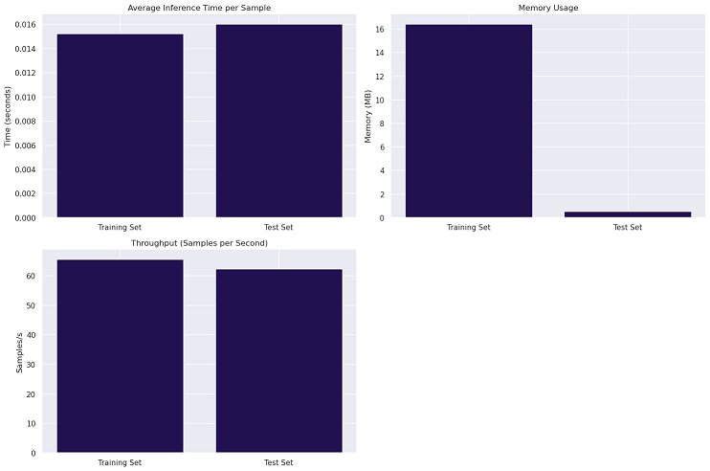
NN #8: Result
Class | Precision | Recall | F1-Score | Support
Negative | 0.35 | 0.5 | 0.41 | 24
Neutral | 0.21 | 0.36 | 0.26 | 39
Positive | 0.97 | 0.93 | 0.95 | 934
Accuracy |  |  | 0.9 | 997
Inference Time per Sample | 0.0160 seconds
Memory Usage | 0.51 MB

Slide 27
NN #9: SBERT + Embedding Scaling + Auto encoder + Simple NN + Pipeline of Models
Component | Description
Input | 384-dimensional SBERT embedding vector per sample
Data Balancing | SMOTE-Tomek applied to embeddings
Optimizer | Adam / AdamW (learning rate = 0.001)
Loss Function | MSELoss for Autoencoder; CrossEntropyLoss for classifiers
Training Callbacks | Custom training loops with progress bars (no built-in callbacks)
Regularization | Dropout (0.3) applied after dense layers in classifiers
Batch Normalization | Not explicitly used (standardization done via sklearn StandardScaler)
Stage | Model | Layer No. | Layer Type | Output Units | Activation | Dropout Rate | Notes
Stage 1 | Autoencoder Encoder | 1 | Linear | 256 | ReLU | - | Encoder part of autoencoder
 |  | 2 | Linear | 128 | ReLU | -
 |  | 3 | Linear | 64 | None | - | Encoded representation
 | Binary Classifier | 4 | Linear | 128 | ReLU | 0.3 | Classifier input layer
 |  | 5 | Linear | 64 | ReLU | 0.3
 |  | 6 | Linear | 2 | None | 0 | Output layer (Positive vs Rest)
Stage 2 | Autoencoder Encoder | 1 | Linear | 256 | ReLU | - | Separate autoencoder for Neutral vs Negative
 |  | 2 | Linear | 128 | ReLU | -
 |  | 3 | Linear | 64 | None | - | Encoded representation
 | Secondary Classifier | 4 | Linear | 128 | ReLU | 0.3 | Classifier input layer
 |  | 5 | Linear | 64 | ReLU | 0.3
 |  | 6 | Linear | 2 | None | 0 | Output layer (Neutral vs Negative)

Slide 28
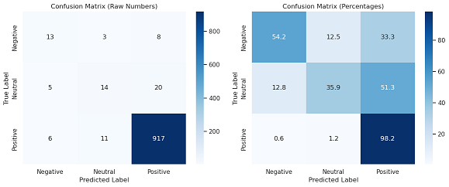
NN #9: Result
Class | Precision | Recall | F1-Score | Support
Negative | 0.53 | 0.42 | 0.47 | 24
Neutral | 0.45 | 0.38 | 0.42 | 39
Positive | 0.97 | 0.98 | 0.98 | 934
Accuracy |  |  | 0.94 | 997
Inference Time per Sample | 0.0009 seconds
Memory Usage | 0.93 MB

Slide 29
NN #10: NN #9 + SMOTE
Component | Key Notes
Autoencoder | - Trained separately for Positive and Neutral classes - Uses MSE Loss for reconstruction - No dropout in autoencoder layers - Encoding dimension default is 64 - Used for dimensionality reduction
Binary Classifier NN | - Uses dropout (0.3) to prevent overfitting - Trained with Cross Entropy Loss - Uses AdamW optimizer - Final layer outputs logits for 2 classes
Two-Stage Pipeline | - Stage 1: Positive vs Rest classification - Stage 2: Only processes "Rest" samples to classify Neutral vs Negative - Each stage has its own autoencoder and classifier - Two-Stage Pipeline: Stage 1 focuses on Positive vs Rest; Stage 2 focuses on Neutral vs Negative within the Rest group.
Data Handling | - SMOTE applied to balance classes in both stages - Standard Scaler used to normalize embeddings - SBERT model 'all-MiniLM-L6-v2' used for text embeddings - Input Dimension (input_dim) corresponds to the SBERT embedding size (e.g., 384 for 'all-MiniLM-L6-v2').
Dropout | Dropout is applied only in the classifier to reduce overfitting.

Slide 30
NN #10: NN #9 + SMOTE
Model Name | Layer Type | Input Size | Output Size | Activation | Dropout | Purpose
Autoencoder Encoder | Linear | 384 | 256 | ReLU | No | Feature extraction
 | Linear | 256 | 128 | ReLU | No
 | Linear | 128 | 64 | None | No | Encoded representation
Autoencoder Decoder | Linear | encoding_dim | 128 | ReLU | No | Reconstruction
 | Linear | 128 | 256 | ReLU | No
 | Linear | 256 | 384 | None | No | Reconstructed embedding output
Binary Classifier | Linear | input_size | 128 | ReLU | Yes (0.3) | Hidden layer
 | Linear | 128 | 64 | ReLU | Yes (0.3) | Hidden layer
 | Linear | 64 | 2 | None | No | Output logits for 2 classes

Slide 31
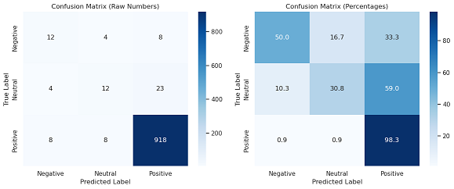
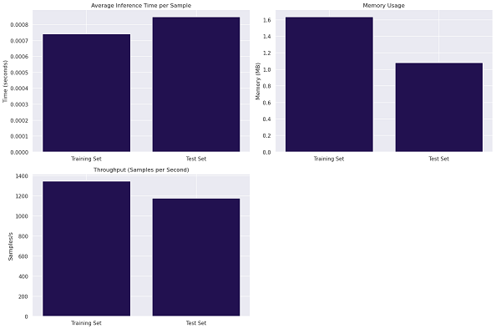
NN #10: Result
Class | Precision | Recall | F1-Score | Support
Negative | 0.5 | 0.5 | 0.50 | 24
Neutral | 0.5 | 0.31 | 0.38 | 39
Positive | 0.97 | 0.98 | 0.98 | 934
Accuracy |  |  | 0.94 | 997
Inference Time per Sample | 0.0008 seconds
Memory Usage | 1.08 MB

Slide 32
Neural Network Model Performance

Slide 33
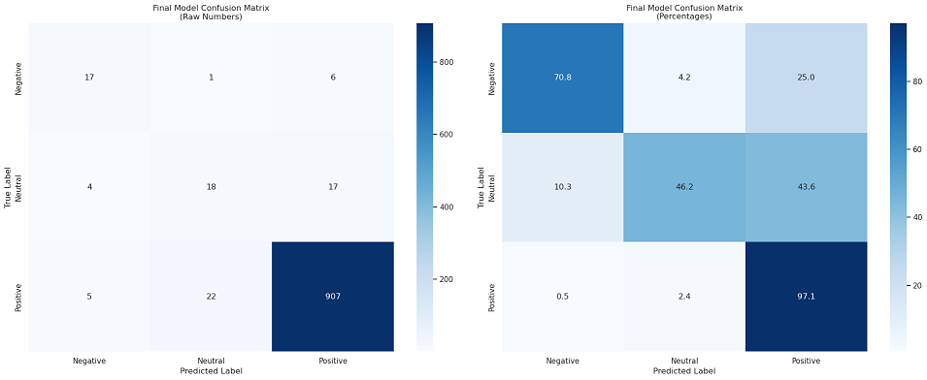
Final Ensemble
Class | Precision | Recall | F1-Score | Support
Negative | 0.65 | 0.71 | 0.68 | 24
Neutral | 0.44 | 0.46 | 0.45 | 39
Positive | 0.98 | 0.97 | 0.97 | 934
Accuracy |  |  | 0.94 | 997

Slide 34
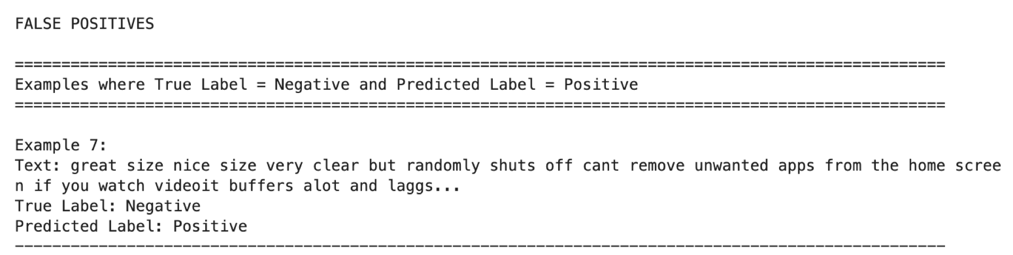
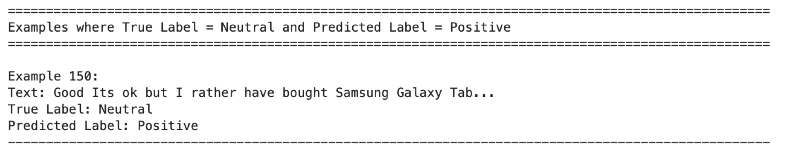
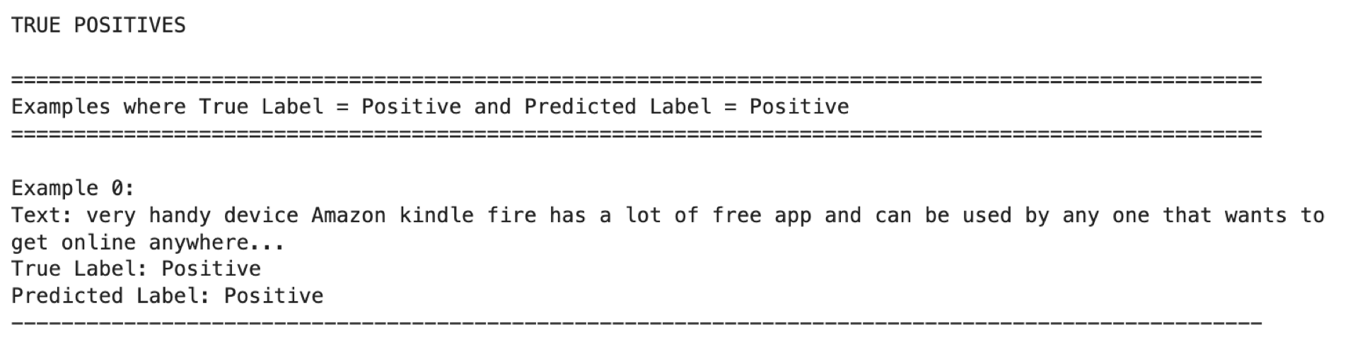
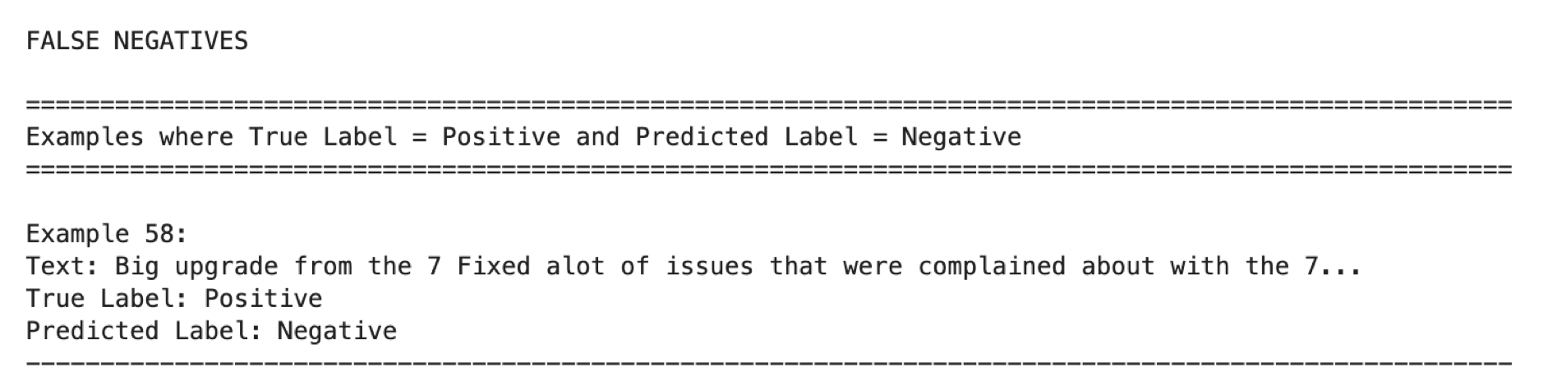
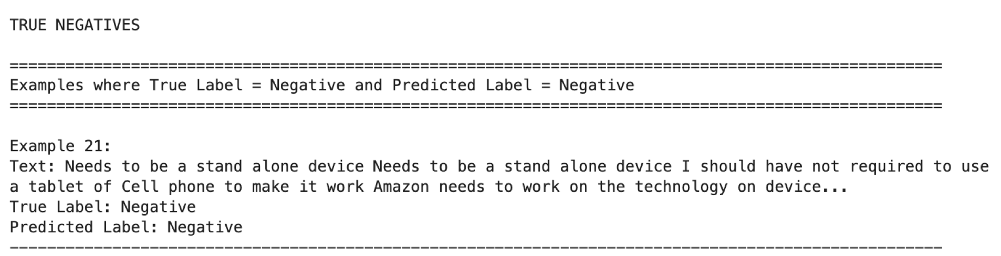
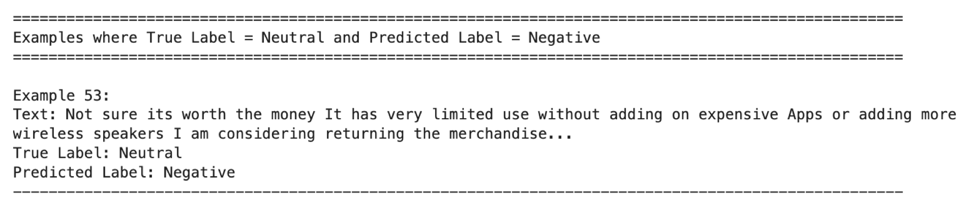
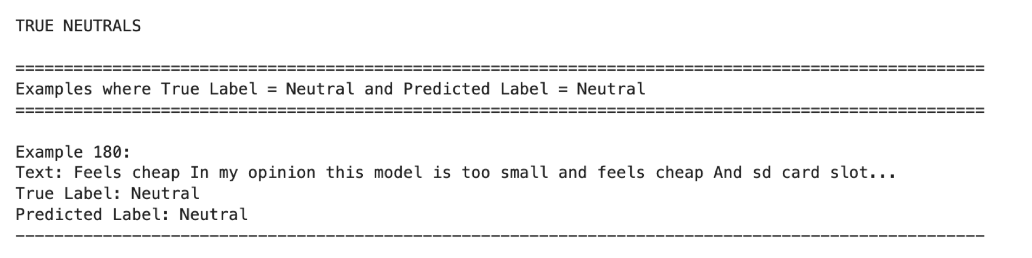
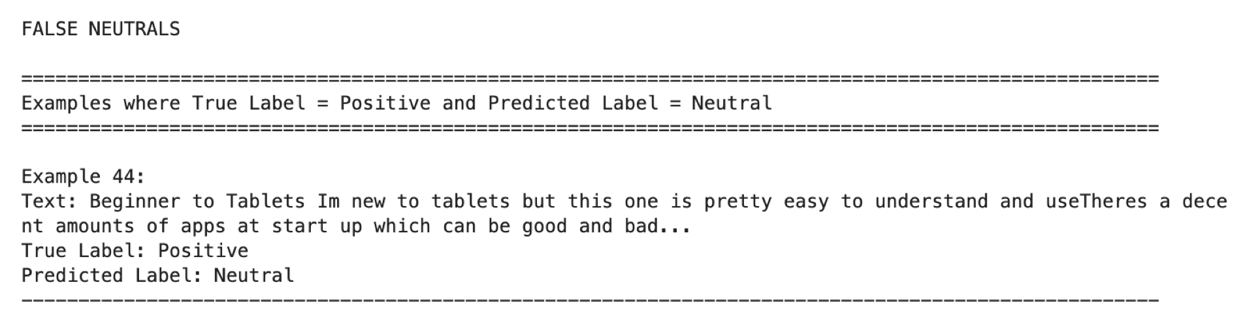
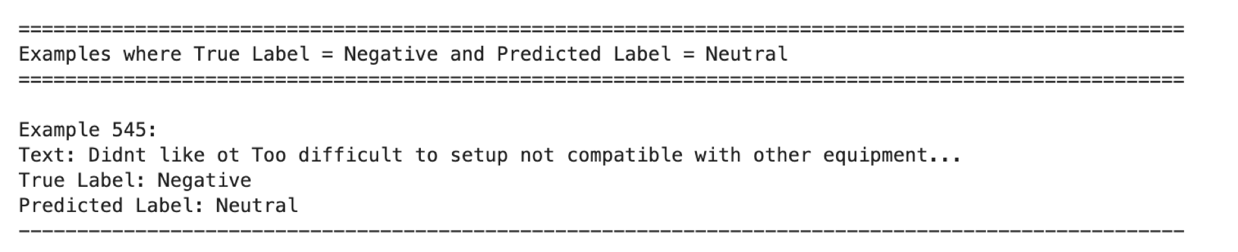
Samples

Slide 35
Section 3: Fine Tuning a Pre-Trained Model

Slide 36
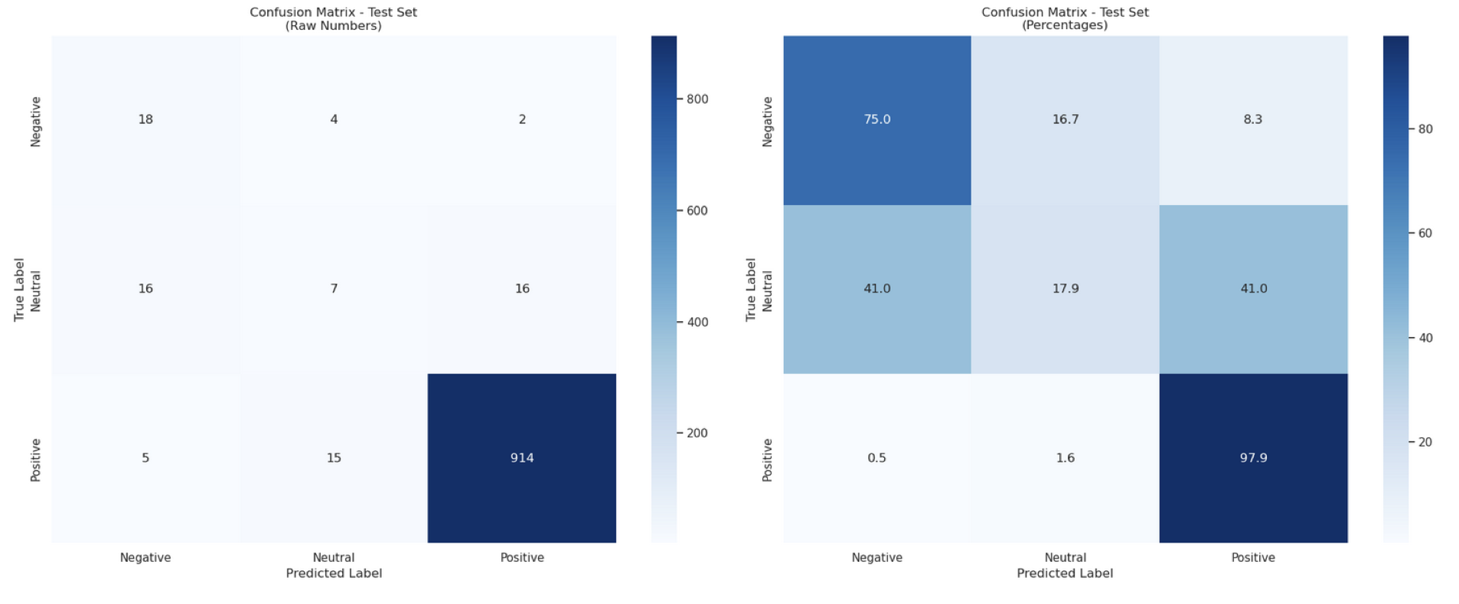
RoBERTa #1 : Pre-trained RoBERTa Sentiment Classifier
Class | Precision | Recall | F1-Score | Support
Negative | 0.46 | 0.75 | 0.57 | 24
Neutral | 0.27 | 0.18 | 0.22 | 39
Positive | 0.98 | 0.98 | 0.98 | 934
Accuracy |  |  | 0.94 | 997

Slide 37
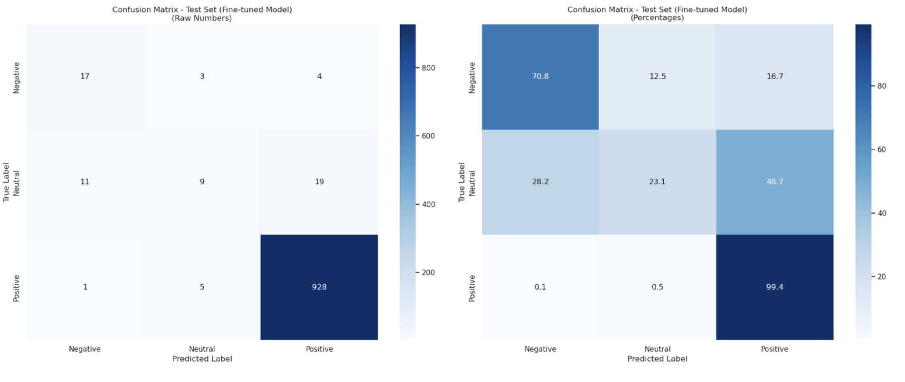
RoBERTa #2 : Fine-tuned RoBERTa Sentiment Classifier
Class | Precision | Recall | F1-Score | Support
Negative | 0.59 | 0.71 | 0.64 | 24
Neutral | 0.53 | 0.23 | 0.32 | 39
Positive | 0.98 | 0.99 | 0.98 | 934
Accuracy |  |  | 0.96 | 997

Slide 38
Section 4: Using LLMs for Sentiment Classification

Slide 39
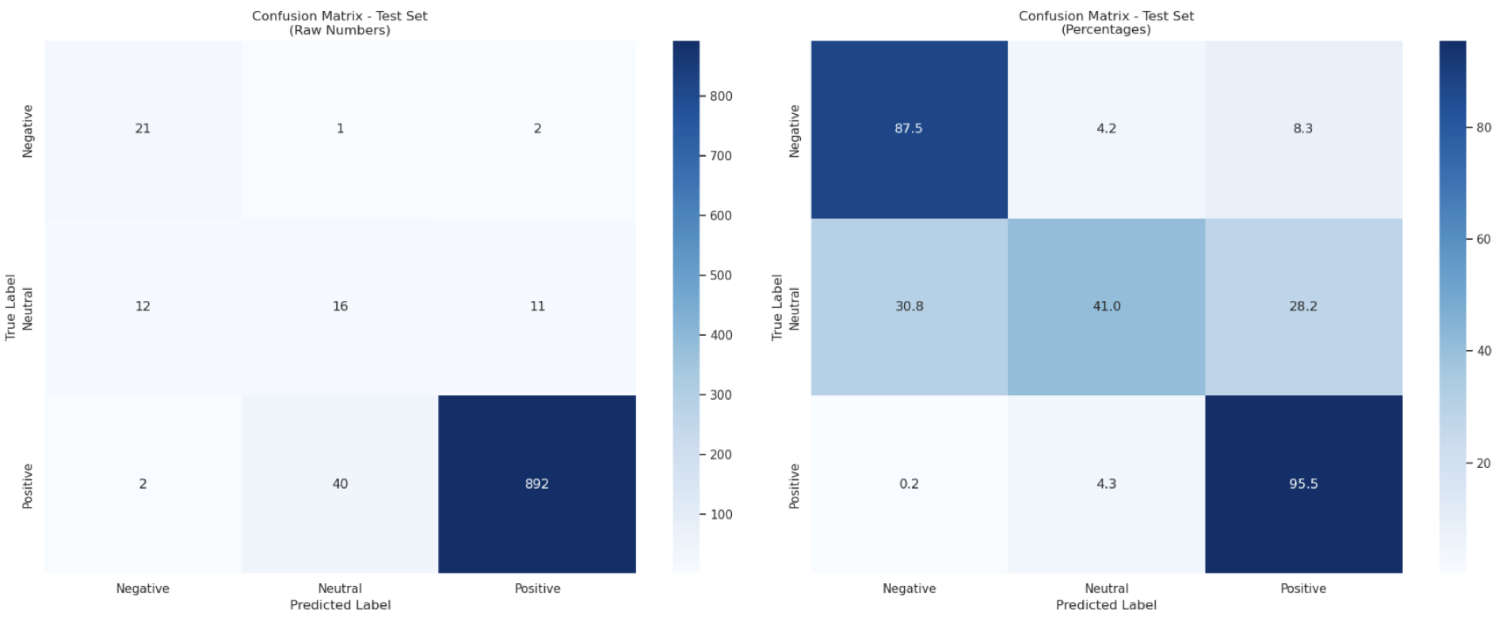
Gen AI : Anthropic Claude Sonnet 3 with Few Shot Prompting
Class | Precision | Recall | F1-Score | Support
Negative | 0.60 | 0.88 | 0.71 | 24
Neutral | 0.28 | 0.41 | 0.33 | 39
Positive | 0.99 | 0.96 | 0.97 | 934
Accuracy |  |  | 0.93 | 997

Slide 40
Section 5: Using Conventional ML techniques and Embeddings

Slide 41
ML Prototypes : Conventional Model Variations
Model | SBERT | SMOTE | Count Vectorizer | TF-IDF | Word2Vec | Neural Network | Random Forest | SVM
Conv #1 | ✓ | ✓ |  |  |  |  | ✓
Conv #2 | ✓ | ✓ |  |  |  |  |  | ✓
Conv #3 |  | ✓ | ✓ |  |  | ✓
Conv #4 |  | ✓ |  | ✓ |  | ✓
Conv #5 |  | ✓ |  |  | ✓ | ✓

Slide 42
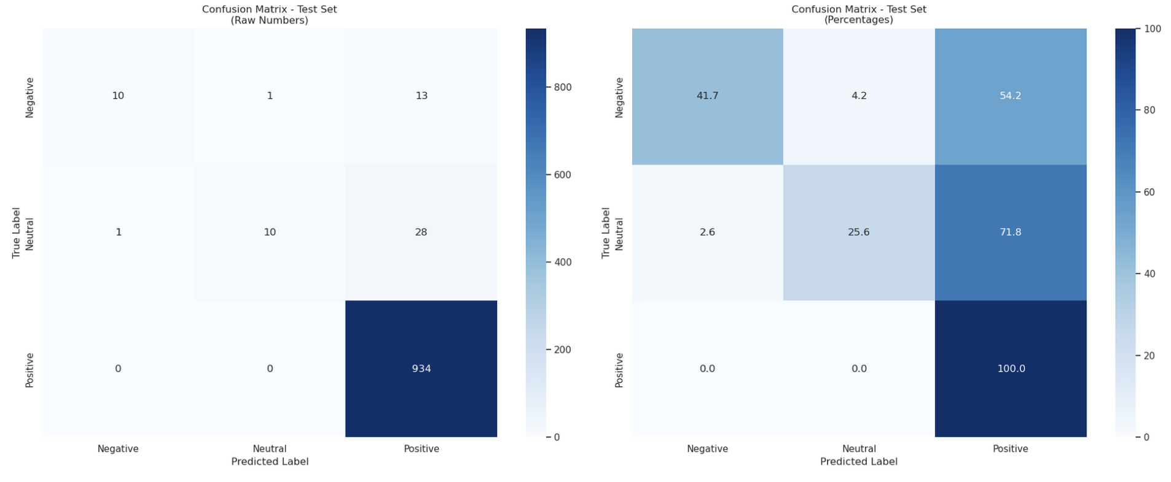
Conv #1 : Using Random Forest Classifier and SBERT Embeddings
Class | Precision | Recall | F1-Score | Support
Negative | 0.91 | 0.42 | 0.57 | 24
Neutral | 0.91 | 0.26 | 0.40 | 39
Positive | 0.96 | 1.00 | 0.98 | 934
Accuracy |  |  | 0.96 | 997

Slide 43
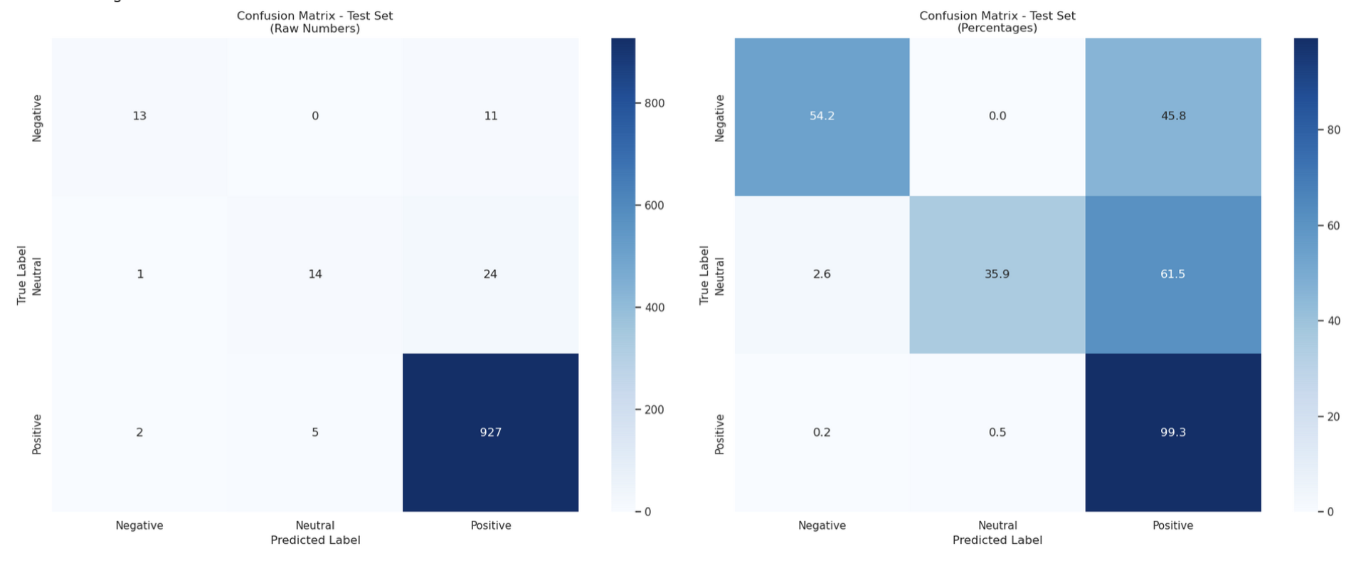
Conv #2 : Using SVM and SBERT Embeddings
Class | Precision | Recall | F1-Score | Support
Negative | 0.81 | 0.54 | 0.65 | 24
Neutral | 0.74 | 0.36 | 0.48 | 39
Positive | 0.96 | 0.99 | 0.98 | 934
Accuracy |  |  | 0.96 | 997

Slide 44
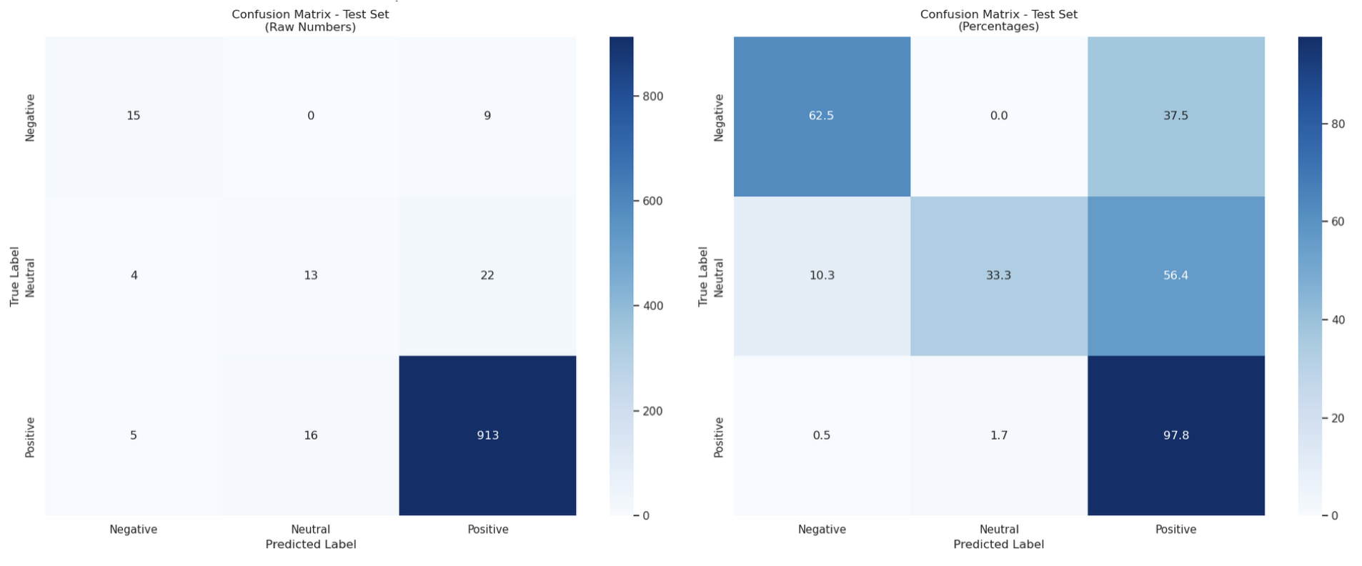
Conv #3 : Using Neural Network and CountVectoriser
Class | Precision | Recall | F1-Score | Support
Negative | 0.44 | 1.00 | 0.61 | 24
Neutral | 0.21 | 0.95 | 0.35 | 39
Positive | 1.00 | 0.82 | 0.90 | 934
Accuracy |  |  | 0.83 | 997

Slide 45
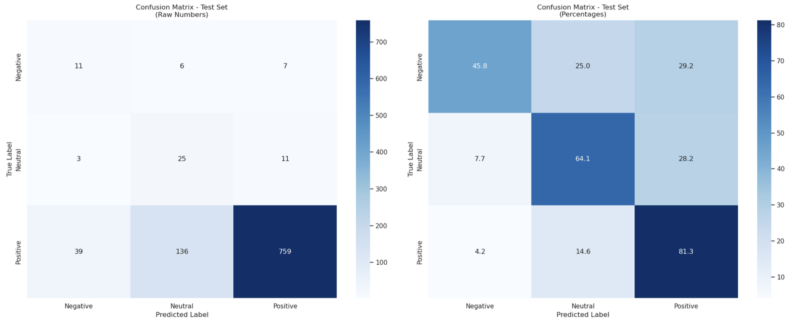
Conv #4 : Using Neural Network and Word2Vec
Class | Precision | Recall | F1-Score | Support
Negative | 0.21 | 0.46 | 0.29 | 24
Neutral | 0.15 | 0.64 | 0.24 | 39
Positive | 0.98 | 0.81 | 0.89 | 934
Accuracy |  |  | 0.80 | 997

Slide 46
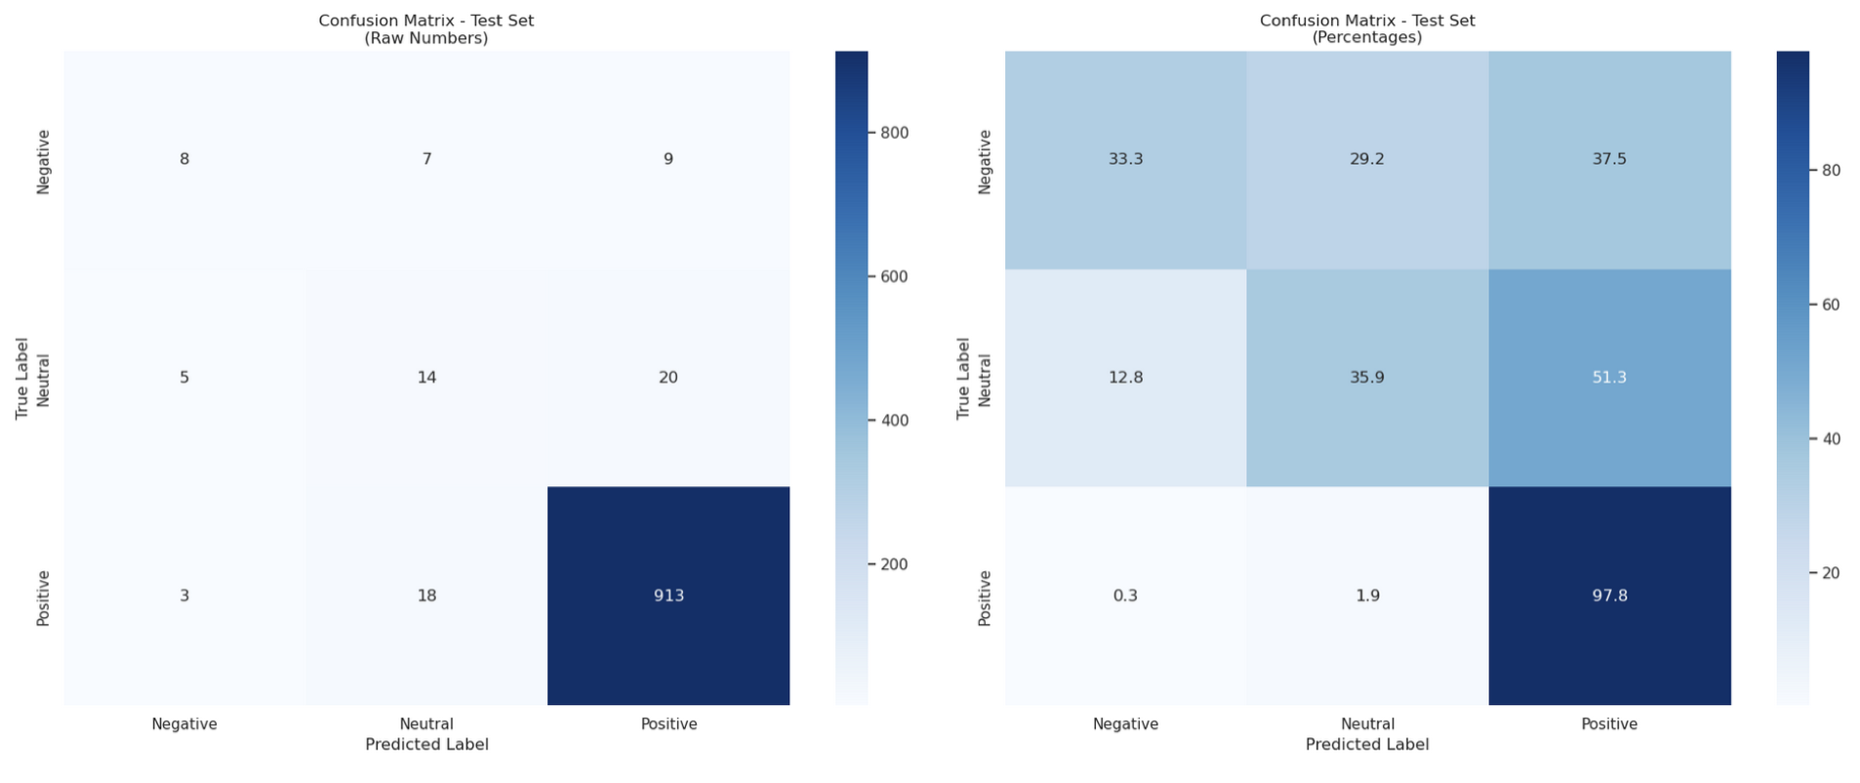
Conv #5 : Using Neural Network and TF-IDF
Class | Precision | Recall | F1-Score | Support
Negative | 0.50 | 0.33 | 0.40 | 24
Neutral | 0.36 | 0.36 | 0.36 | 39
Positive | 0.97 | 0.98 | 0.97 | 934
Accuracy |  |  | 0.94 | 997

Slide 47
Comparing Neural Networks with Conventional ML Modelling

Slide 48
Issues with the Dataset

Slide 49
Issues with Test Dataset
Incorrect Labelling on the Test Dataset
[Review Title] Text | Target Label
[Good tablet 4 kids] This tablet is grrrrrrreeeeeeeeaaaaaattttttt for the children! | Neutral
[Good for books] The kindle is good to download apps for books catch up with reading | Neutral
[Good product] It was great product. the price which I got it was great. | Neutral
[The tablet I bought was a 3th birthday gift..] Gave it to my granddaughter and she loves it..I want to buy one for myself.... | Negative
[great little device] fire tablet is very powerful for the size and does everything! | Negative
[Present for my dad] Got it as a gift for my dad, so far so good.Didn't not realise the special offers are ads, spend more money to buy the one with out them.Also hate the fact they removed the wwan connection, you now need wifi to connect to the store. | Positive
… | …

Slide 50
Section 6: Conclusion and Model Outcomes Comparison

Slide 51
Model Outcomes
Transformer based models using a two-stage sequential classification pipeline outperformed the simpler architectures, including even the LLMs on “Neutral” class detection.
Ensemble technique significantly enhanced the performance improvising the robustness.
Multiple strategies like SMOTE/SMOTE Tomek, Weighted Sparse Categorical Cross Entropy Loss Function were employed to address class imbalance problem.
To improve “Precision” and “Recall” for the minority classes, deeper and more complex neural networks were built, increasing the risk of overfitting. This was mitigated using advanced techniques like Batch/Layer Normalization, L2 Regularization, Dropouts, Model Checkpoints, Early Stopping, ReduceLROnPlateau etc.
As the model complexity increased, interpretability diminished. Tools like SHAP were unable to effectively explain the prediction process of neural networks.
Traditional ML models provided better interpretability but lacked the Precision and Recall required for accurate classification of the minority classes, unlike neural ensemble methods.
While F1 scores for majority (Positive) class remained consistently high (>0.95), performance for minority classes suffered due to high class imbalance which is further worsened by data labelling errors.
Simpler models like NN#1 and NN#2 were most resource-efficient and faster to train.
Models struggled with reviews that contained ambiguous and mixed sentiments affecting classification consistency.

Slide 52
Section 7: Documentation and Code Base

Slide 53
Github Link
Git Code Repo:
PowerPoint Presentation:
Document:

Slide 54
References
Text Preprocessing:
Bird, S., Klein, E., & Loper, E. (2009). Natural Language Processing with Python. O'Reilly Media.
https://www.nltk.org/
Sentiment Analysis Techniques:
Liu, B. (2012). Sentiment Analysis and Opinion Mining. Synthesis Lectures on Human Language Technologies.
https://www.cs.uic.edu/~liub/FBS/sentiment-analysis.html
Machine Learning Models:
Scikit-learn Documentation: https://scikit-learn.org/stable/
XGBoost Documentation: https://xgboost.readthedocs.io/
Deep Learning for NLP:
Vaswani, A., et al. (2017). Attention is All You Need. NeurIPS.
Hugging Face Transformers: https://huggingface.co/transformers/
Evaluation Metrics:
Sokolova, M., & Lapalme, G. (2009). A Systematic Analysis of Performance Measures for Classification Tasks. Information Processing & Management.

Slide 55
Thank You!
Group 8

